Slide 1
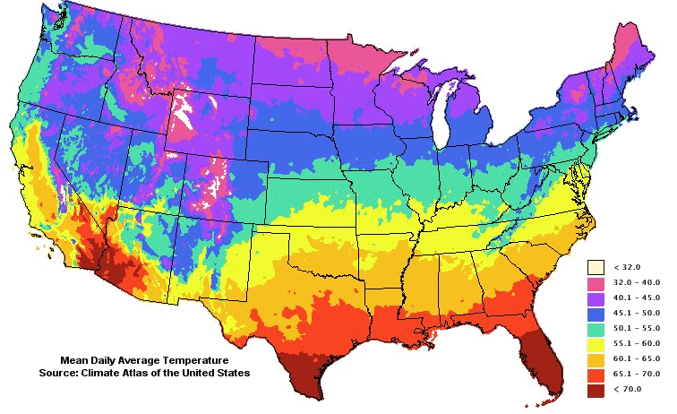
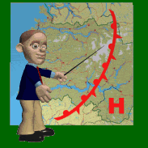

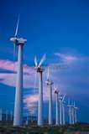
What properties of air do we look at when we study weather?
Air Pressure
Temperature
Humidity
Wind Speed and Direction

Slide 2
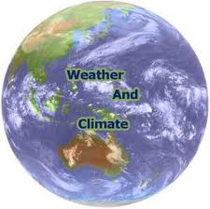
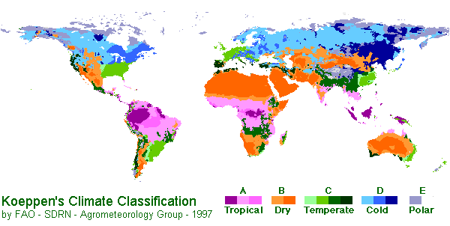
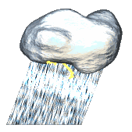
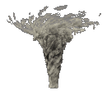
Climate vs Weather
Climate is the temperature and moisture conditions of an area over a LONG period of time.
Weather is the atmospheric conditions in a specific area at a specific time

Slide 3
Air Masses and Fronts
Air Masses: formed when air in the atmosphere is heated at the equator and cooled at the poles.
Fronts: formed when two air masses of different temperatures and humidity* bump into each other.
*Humidity is the amount of water vapor
in the air.

Slide 4
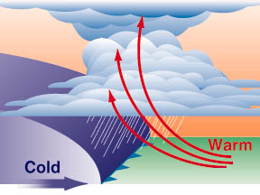
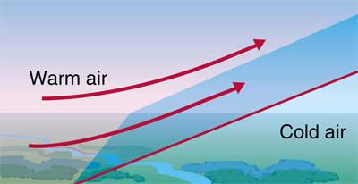
Types of Fronts
Cold front
Warm front
Cold air mass pushes into a warm air mass.
Warm air mass pushes into a cold air mass.

Slide 5
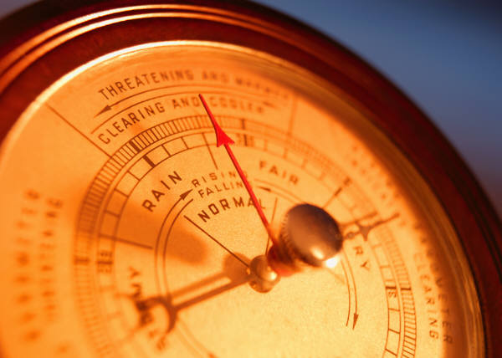
Air Pressure
Air pressure is the force of the air pressing down (sometimes called atmospheric pressure)

Slide 6
Do weather forecasters use air pressure to predict the weather?
High pressure areas are formed when air is cooled.
Low pressure is formed when air is warmed. Weather associated with low pressure areas are: clouds, rain, and wind.

Slide 7

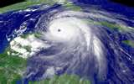
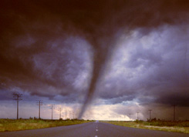
Storms
Thunderstorms
Tornadoes
Hurricanes

Slide 8
CLOUDS
Clouds are formed when warm air carrying water vapor rises from the Earth and the water vapor cools down and connect to each other.
Are all clouds the same?

Slide 9
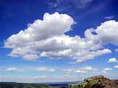
Cumulus
Fluffy, white clouds with flat bottoms. Cumulus clouds usually indicate fair weather. (Middle)
Notes:
Cotton balls

Slide 10
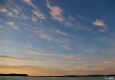
Cirrus
Feathery, wispy, clouds; associated with fair weather. They often indicate that rain or snow will fall within hours. (High)
Notes:
Tiny ice crystals instead of water vapor

Slide 11
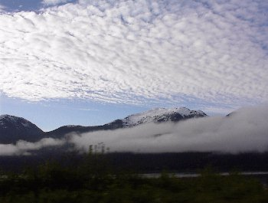
Stratus
Flat, smooth, gray clouds that blanket/cover the whole sky. (low)
Notes:
Light rain and drizzle

Slide 12
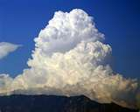
Cumulo-nimbus
Foul weather storm clouds that bring heavy rains and thunderstorms.
Notes:
Cumulus clouds joining together

Slide 13
Spot the cloud 1
Low and flat …..
Called?
Stratus

Slide 14
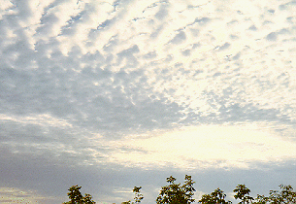
Spot the cloud 2
Middle level,
fluffy …..
Called?
Cumulus

Slide 15
Spot the cloud 3
High level,
wispy …..
Called?
Cirrus

Slide 16
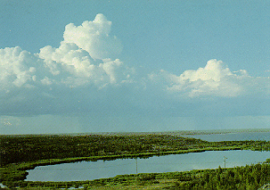
Spot the cloud 4
Rain bearing,
storm clouds …..
Called?
Cumulo-Nimbus

Slide 17
How do meteorologists forecast weather?

Slide 18

What is a cold front?
The cold front is colored blue. The triangles show you which way it is moving. The cold front is the front of the cold air. It may make rain or snow showers.

Slide 19

What is a warm front?
The warm front is colored red. The half-circles show you which way it is moving. It is the front of the warm air and it may make steady rain or snow

Slide 20
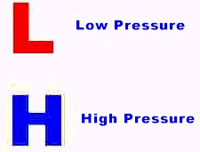
What is high pressure?
High pressure has wind that blows around it in the direction of a clock- that's called clockwise. It is colored blue and usually means dry, clear weather.

Slide 21
What is low pressure?
Low pressure is colored red and it has wind that blows around it in the opposite direction of a clock-counterclockwise. It usually brings cloudy, wet, or stormy weather.

Slide 22
Two more interesting weather facts:
Weather moves from west to east, about 500 miles a day. It moves faster in the winter.
High, cold air travels faster than low, warm air.

Slide 23
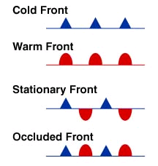
What is a stationary front?
Two air masses that have met and are not moving are called a stationary front.

Slide 24
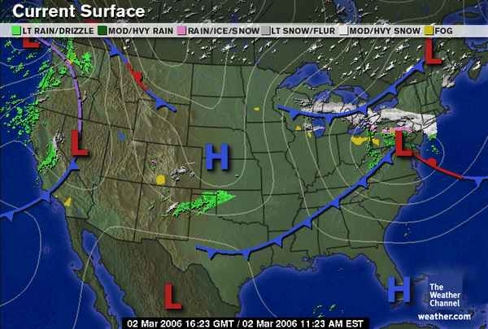
1

Slide 25
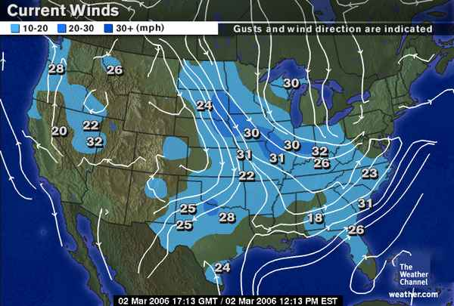
2

Slide 26
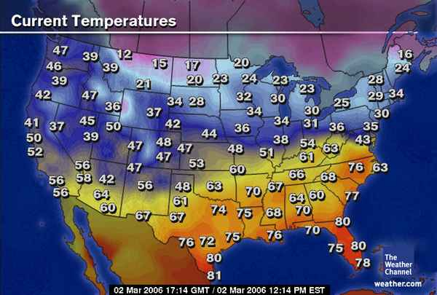
3

