Slide 1
How do simple machines help us do work?

Slide 2
WORK:
exertion or effort directed to produce or accomplish something; labor; toil (definition from dictionary.com)
Something that makes you tired (basically everything you do including breathing, unless you are completely still and frozen solid).

Slide 3
Lever:
Description: a stiff bar that rests on a fulcrum
How it helps us work: lifts or moves a load
Examples: seesaw, shovel, crowbar

Slide 4
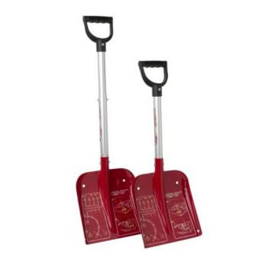

Slide 5
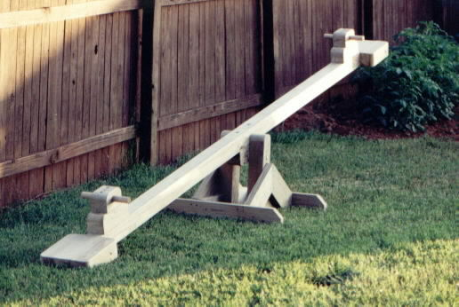
Can you think of any other examples of levers?

Slide 6
Inclined plane:
Description: is a flat surface with one end raised higher than the other
How it helps us work: moves things up and down
Examples: slide, ramp, mountain road

Slide 7
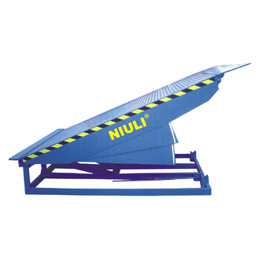

Slide 8
Can you think of any other examples of inclined planes?

Slide 9
Wheel and axle:
Description: a wheel with a rod called an axle through the center…axle and wheel move together.
How it helps us work: lifts or moves a load
Examples: doorknob, pencil sharpener,
bike wheel

Slide 10
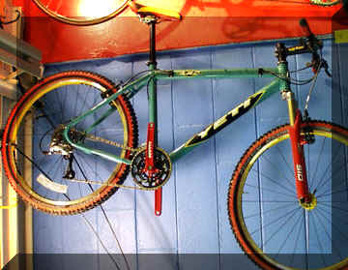

Slide 11
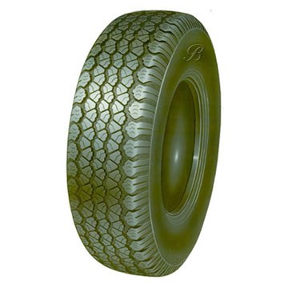
Can you think of any other examples of wheels and axles?

Slide 12
Screw:
Description: an inclined plane wrapped around a rod or cylinder
How it helps us work: holds things together
Examples: drill bit, spiral staircase, screw-on-lid

Slide 13
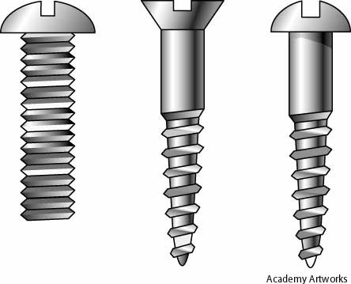

Slide 14
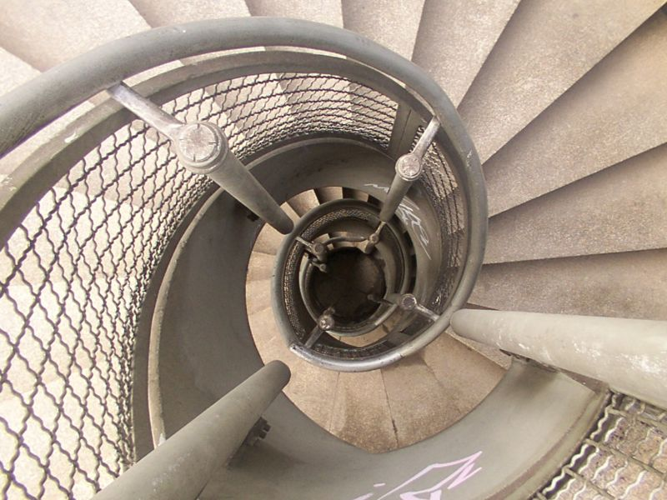
Can you think of any other examples of screws?

Slide 15
Pulley:
Description: a grooved wheel with a rope around it.
How it helps us work: moves things up, down, or across
Examples: flag pole, curtain rod, sailboat mast

Slide 16
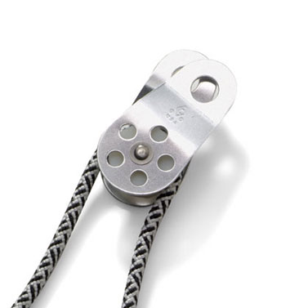

Slide 17
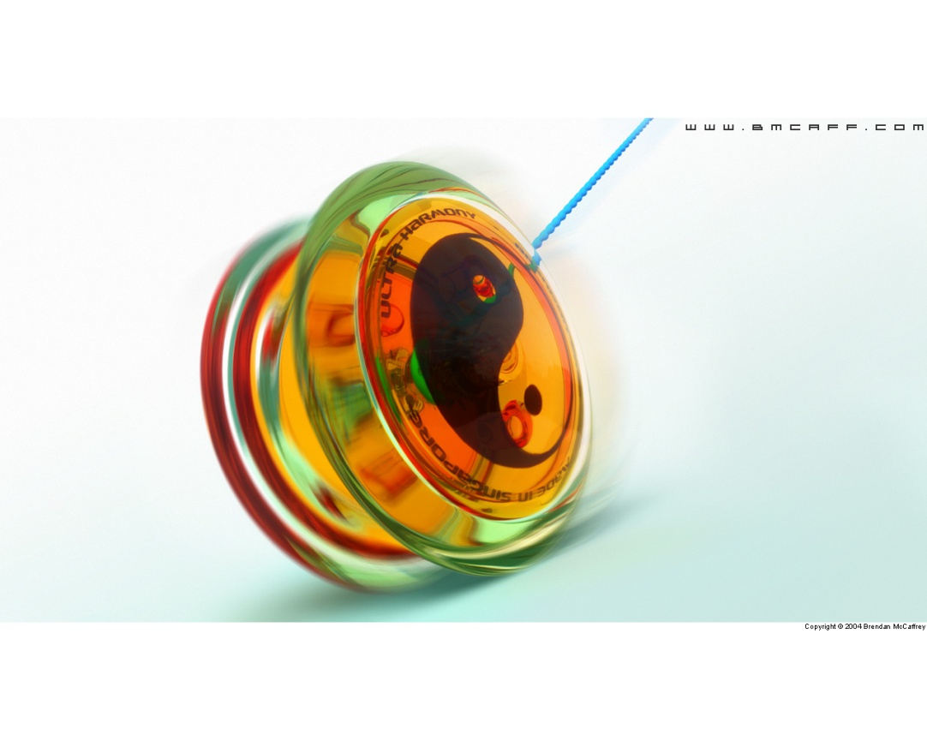
Can you think of any other examples of pulleys?

Slide 18
Wedge:
Description: two inclined planes put together, creating one sharp edge
How it helps us work: cuts or spreads an object apart
Examples: knife, wood chisel, needle

Slide 19
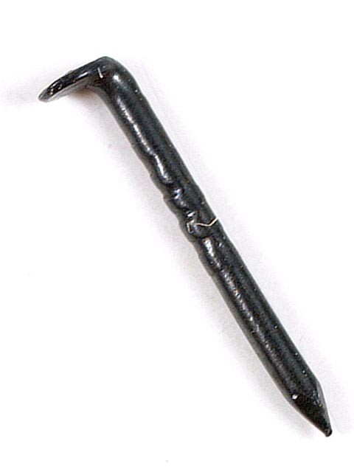

Slide 20
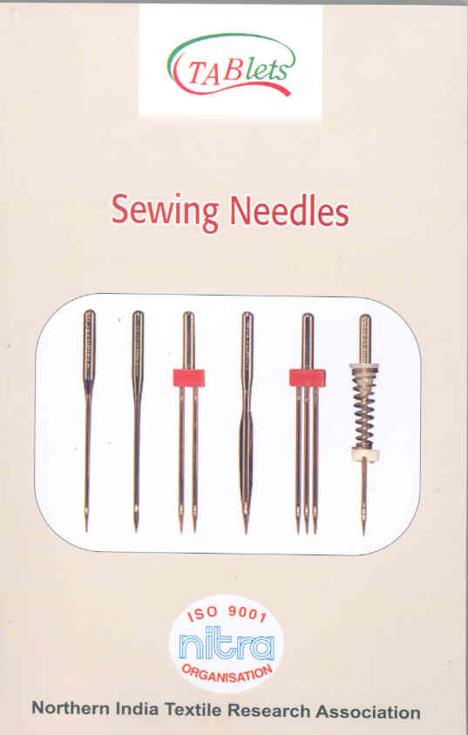
Can you think of any other examples of wedges?

Slide 21
Two questions to see how much you’ve learned?
1. How are an inclined plane and a wedge alike? How are they different?
2. How are a screw and a wheel and axle alike? How are they different?

